Slide 1
Chiropractic Management of Toxicity
Kevin Cabriales
Lan Nguyen

Slide 2
What is Toxicity
We live in an increasingly toxic environment. Many of these toxins can be trapped in the body and accumulate over time, leading to a decrease in functional capacity of liver, kidneys and other pathways of elimination.
Additionally, other toxins are able to cause a plethora of side effects including neurological symptoms, hormone disruption and can persist for long periods or indefinitely in the body, continually affecting pathways

Slide 3
Types of Toxicity
Environmental Health Toxicity: environmental toxins
Ecotoxicity: environmental contaminants of ecosystems and constiuents of the ecosystem (fish, etc) which also leads to bioaccumulation within human consumers.
Examples: Fukushima TEPCO disaster, organophosphate runoff and contamination of aquifers, pesticide runoff and residues on food
Ex: Antibiotic use in commercial agriculture

Slide 4
Sources of Toxins
Main sources of toxins: Air, Water, Food
100 percent of children are found to be exposed to excessive arsenic, dioxins and pesticides in latest study
Mycotoxins in major food staples which can cause a variety of adverse effects

Slide 5
Physiological Effects of Toxins
Endocrine Disruption (BPA’s)
Neurological Disruption (lead, flouride, mercury)
Nephrotoxicity(mercury, flouride, antibiotics)

Slide 6
How Toxins Are Removed normal process of elimination
The disposal of cellular waste products, especially lactic acid
The removal of larger waste products through your lymph (smaller waste products go into your veins and are exhaled or sent directly to your liver).
The processing of toxins by your liver, most of which then go into bile and then into your digestive tract for final clearance (some are made water-soluble and go to your kidneys to be excreted in urine).
The final clearance of waste products by your digestive tract.

Slide 7
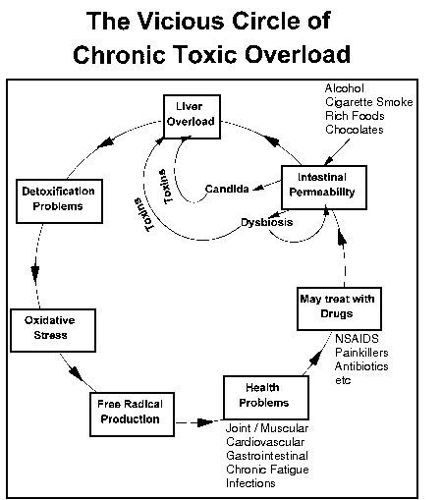
Toxic buildup
The liver becomes overwhelmed and systems start backing up and process intermediate and waste products less efficiently

Slide 8
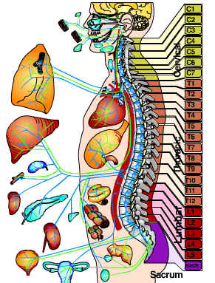
Chiropractic Management
Detoxification is key.
Chiropractic Adjusting the body helps the body in detoxification process through various methods:
Enhancing liver activity which helps the body to process and eliminate toxins more efficiently

Slide 9
More benefits of chiropractic
Chiropractic adjustments aid in vascular and neurological balancing which aids various organs in the body’s ability to eliminate toxins
Adjustments have been shown to decrease salivary cortisol levels (an indicator of stress response)
Research has been shown to increase immune function (IgA level modulation) which can help the body monitor levels of toxins and successful recognition of toxins.

Slide 10
Other recommendations
Whole foods that naturally aid in detoxification: Include heavy metal chelators such as Basil, Oregano and Cilantro.
Stinging nettle, dandelion and other herbs for liver, kidney and blood detoxification.
Activated charcoal and bentonite clay are charged particles that bind toxins with charged and eliminate them
Herb concentrates that stimulate natural detoxification such as

Slide 11
Other recommendations continued..
Sauna, Hot Spring, Epsom salt bath: naturally help to detoxify through diaphoresis
Alkaline Diet: Enables the body to reduce fats and rid the body naturally of toxins with a balanced pH
Intermittent Fasting: also optimizes natural detoxification processes of the body when a break between digestion is present.

Slide 12
Questions
1) What are physiological effects of toxins?
A. Endoncrine disruption
B. Neurological disruption
C. Nephrotoxicity
D. All of the above
2) Through what mechanism are toxins able to be passed on?
A. Genetics (hereditary)
B. persistence
C. Bioaccumulation
D. Toxins are not passed on, they remain in the organism

Slide 13
Questions
3. True or False: toxins are found in air, water and major food sources
4. Research has been shown to increase immune function (_____ level modulation) which can help the body monitor levels of toxins and successful recognition of toxins.
A. IgA
B. IgG
C. IgE
D. IgM

Slide 14
questions
5. Which foods naturally detox the body?
A. Oregano
B. Cilantro
C. Basil
D. All of the above

Slide 15
References
Dimmick KR, Young MF, Newell D. Chiropractic manipulation affects the difference between arterial systolic blood pressures on the left and right in normotensive subjects. J Manipulative Physiol Ther. 2006 Jan;29(1):46-50. PubMed PMID: 16396729.
Hannon, Sean M. Objective Physiologic Changes and Associated Health Benefits of Chiropractic Adjustments in Asymptomatic Subjects: A Review of the Literature http://sheya.ru/s/asymptomatic-chiropractic-benefits.pdf
Roy RA, Boucher JP, Comtois AS. Inflammatory response following a short-term course of chiropractic treatment in subjects with and without chronic low back pain. J Chiropr Med. 2010 Sep;9(3):107-14. doi: 10.1016/j.jcm.2010.06.002. PubMed PMID: 22027032; PubMed Central PMCID: PMC3188345.
Sarich, Christina. „14 ways to cleanse the body from chemtrails, GMOs, fluoridated water, and other environmental Toxins.“ The Truth Theory. http://truththeory.com/2013/03/29/14-ways-to-cleanse-the-body-from-chemtrails-gmos-flouridated-water-and-other-environmental-toxins/

